Slide 1
Small Vocabulary Speech Recognition for Chhattisgarhi

Slide 2
Presented by:
Aman Kumar Seth (CSE - 16100009)
Himanshu Singh (CSE - 16100030)
Mayank Kumar Giri (CSE - 16101032)

Slide 3
Content
Introduction
Data Collection
Feature Extraction
Algorithm and Approches
GUI
Conclusion
References

Slide 4
Introduction
Objective - To make an Automatic Speech Recognition system for Chhattisgarhi language.
Current focus - Recognizing small vocabulary of Chhattisgarhi with a decent accuracy.

Slide 5
Data Collection
The audio samples were recorded in the ‘.wav’ format.
It is an uncompressed format unlike Mp3.
Recordings are reproduced without any loss in the audio quality.
At a sampling rate of 16 kHz
It contains more information than a signal sampled at 8kHz.
Disadvantage of higher sampling rate is the presence of additional noise.
The audio format set to “mono”
Stereo format is used for creating a cinematic experience for the perception of depth in sound.
In this, voice of the speaker is amplified and the other noises are minimized

Slide 6
Contd...
Initial Approach
Selecting the volunteers for recording of 20 words.
Voice data (words) were collected manually using phone
And then trimming the silence part from the word
This turned to be inefficient for collecting large data.
Smarter Approach
Completely automated the data collection process for large dataset.
Instead of words, collected sentences.
Used Python code for trimming and naming the audio files.

Slide 7
Database Architecture
Containing two folders
Training Folder
Sub-folders of each word.
Audio files of 20 speakers for training.
For labeling, direct folder name can be used
Testing Folder
Same as training, only it contains few audio files.

Slide 8
Feature Extraction
Feature extraction is the process of transforming the input data or signal into a set of features which can represent the data well.
Processing techniques using which the audio signals can be converted into numerical feature sets which can then be used for training our machine learning models.
Pyhton’s librosa library is used for feature extraction.

Slide 9
Contd...
The following features were extracted for the audio samples:
MFCC
Mel Spectrogram
Chroma - stft
Tonnetz
Spectral - Contrast

Slide 10
MFCC (Mel-Frequency Cepstral Coefficients)
Cepstrum is the result of taking the inverse fourier transform of the logarithm of the estimated spectrum of the signal
The power cepstrum in particular finds applications in the analysis of human speech.
In MFC , equal spacing of the frequency bands takes place which approximates the human auditory system’s response more closely.
The MFCC function of librosa return a 1D matrix of size 40

Slide 11
Mel Spectrogram
A spectrogram is the visual representation of the spectrum of frequencies of sound or other signal.
Also known as Voicegrams, Sonographs or Voiceprints.
From nonlinear mel scale of frequency, we obtain the Mel Spectrogram.
Mel Scale is a scale of pitches judged by listeners to be equal in distance from one another.

Slide 12
Chroma - stft
The term Chromagram or Chroma feature closely relates to the 12 different classes of pitch.
Also referred to as pitch class profiles.
This is a powerful tool for the analysis of music whose pitches can be meaningfully categorized.
The main property of chromagram is that they capture the melodic and harmonic characteristics of music while being robust and agile to changes in instrumentation and timbre
In this we usually calculate a chromagram from the waveform of the power spectrum

Slide 13
Tonnetz
This feature detects the changes in the harmonic content of the musical audio signals.
A peak in the detection function represents that a transition was made from one harmonically stable region to another.
This algorithm can successfully detect harmonic changes such as chord boundaries in the polyphonic audio recordings.

Slide 14
Spectral Contrast
Octave based Spectral Contrast considers,
Spectral peaks
Spectral valleys
and their difference in each sub-band.
It roughly represents the relative distribution of the harmonic and non-harmonic components in the spectrum.
Like MFCC, it takes the average of the spectral distribution in each sub-band and are thus prone to lose valuable spectral information.

Slide 15
Characteristics of Voices
Main characteristics of the human voice that can be used to uniquely identify it are,
Loudness
It is the magnitude of the change in the air pressure.
the Mel Spectrogram is used to represent the loudness of an audio signal.
Pitch
It is the frequency that tells us the number of times a pressure pattern is repeated per unit time.
Chroma Stft , Spectral Contrast and Tonnetz all tell us about the pitch of the audio samples.
Timbre
General term for the distinguishable characteristics of a tone.
Quality of sound that makes voices sound different from each other.
Mainly determined by the Harmonic content of a sound and the Dynamic characteristics.
Tonnetz gives us an idea about the timbre of the voice

Slide 16
Algorithms and Approaches
Due to lack of huge data, instead of NN, we are recognizing using MFCC (Mel Frequency Cepstral Coefficients) and DTW (Dynamic Time Warping), with the help of some classifier.

Slide 17

Block Diagram
Training
Machine Learning Algorithm
Label
MFCC
DTW
Features
Audio Files
(b) Testing
MFCC
DTW
Classifier Model
Label
Features
Audio Sample

Slide 18
DTW (Dynamic Time Warping)
Dynamic Time Warping is one of the algorithms for measuring similarity between two temporal sequences, which may vary in speed.
References:
[1] A Review on Different Approaches for Speech Recognition System
[2] Speech Recognition using MFCC
[3] Speech recognition using MFCC and DTW

Slide 19
Procedure
After data collection and preprocessing, we use MFCC feature extraction to get
the feature vectors for each sample.
We use these feature vectors to apply DTW to calculate distance or error value of each sample with all others.
Among this, we find the class having minimum DTW distance from our sample to be predicted, that becomes the output.

Slide 20
Precisions of 58 classes in DTW
Precisions
[ 80, 28, -1, 100, 66, 100, 75, 100, 100, 100, 80, 66, 100, 66, 100, 50, 100, 100, 100, 50, 27, 100, 100, 80, 40, 100, 100, 50, 100, 100, 100, 100, 100, 50, 100, 42, 100, 100, 80, 75, 100, 57, 50, 75, 100, 100, 66, 100, 66, 100, 50, 100, 100, 100, 66, 80, 100, -1]

Slide 21
Using Classifiers for Recognition
Initial approach was used as the initial audio samples were quite small in number(800).
As the size of our dataset increased to a significant number (2300+) we switched to the machine learning approach.
Where various models were trained on the feature set.
And the test samples were classified into one of the 58 target classes.

Slide 22
SVM
Support Vector Machine constructs a hyperplane or set of hyperplanes in a high or infinite-dimensional space.
Which can be used for Classification, Regression, or other tasks like Outliers Detection.
A good separation is achieved by the hyperplane that has the largest distance to the nearest training-data point of any class (so-called functional margin).

Slide 23
Precisions of 58 classes in SVM
Precisions
[33.34, 40.0, 16.67, 66.67, 50.0, 50.0, 100.0, 100.0, 40.0, 20.0, 100.0, 33.34, 66.67, 0.0, 33.34, -1, 50.0, 100.0, 100.0, 50.0, 33.34, 100.0, -1, 33.34, 50.0, 57.14285714285714, 75.0, 50.0, 50.0, 100.0, 66.67, 50.0, 100.0, 33.34, 25.0, 33.34, 40.0, 50.0, 33.34, 50.0, 33.34, 33.34, 33.34, 37.5, 75.0, -1, 0.0, 37.5, 33.34, 33.34, 100.0, 66.67, 100.0, 100.0, 50.0, 100.0, 100.0, 0.0]

Slide 24
2. Random Forest
Random forests or random decision forests are an ensemble learning method for classification and regression.
The “forest” it builds, is an ensemble of Decision Trees, most of the time trained with the “bagging” method.
Advantage of random forest is, that it can be used for both classification and regression problems.
It adds additional randomness to the model.

Slide 25
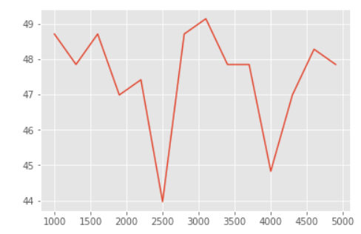
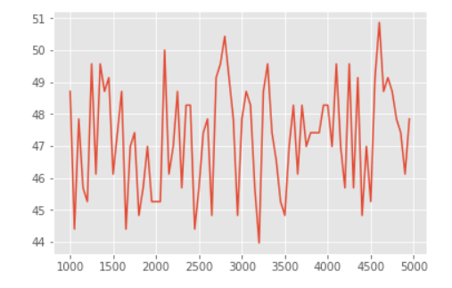
No. of trees vs Accuracy

Slide 26
Precisions of 58 classes in Random Forest
Precisions
[100.0, -1, -1, 66.67, 100.0, 100.0, 100.0, 100.0, 100.0, 42.85, 50.0, 50.0, 40.0, 66.67, 26.67, 100.0, 16.67, 57.14285714285714, 100.0, 57.14, 33.34, 75.0, 66.67, 40.0, 100.0, 60.0, 66.67, 33.34, 100.0, 66.67, 50.0, 75.0, 44.45, -1, 100.0, -1, 33.34, -1, 0.0, 66.67, 37.5, 50.0, -1, 33.34, 57.14, -1, 0.0, 0.0, 0.0, 57.14, 40.0, 100.0, 20.0, 50.0, 66.67, 100.0, 100.0, 33.34]

Slide 27
Contd...
In Random Forest, only a random subset of the features is taken into consideration by the algorithm for splitting a node.
In our dataset the random tree produced satisfactory results as the maximum approach that was achieved was 71%.
This could have increased further by increasing the size of the training dataset.

Slide 28
3. Artificial Neural Network
Neural Network itself is not an algorithm, but rather a framework for many different machine learning algorithms to work together and process complex data inputs.
ANN is based on a collection of connected units or nodes called artificial neurons.
In ANN implementations, the signal at a connection between artificial neurons is a real number, and the output of each artificial neuron is computed by some non-linear function of the sum of its inputs.

Slide 29
Contd...
The basic requirement of this approach was the availability of a huge dataset (minimum 30,000 audio samples) therefore this approach did not produce good results.
We only had 2300 samples and even after bootstrapping the minimum threshold could not be satisfied and so was not included in the final model.

Slide 30
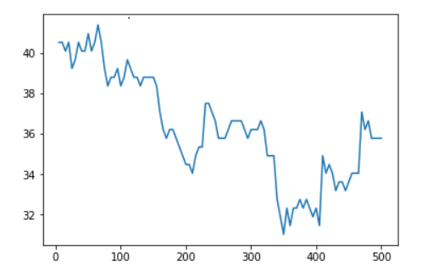
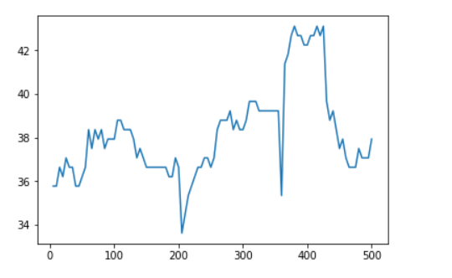
Epochs vs Accuracy

Slide 31
Precisions of 58 classes in ANN
Precisions
[-1, 25.0, 0.0, 37.5, 60.0, 100.0, 33.34, 100.0, 28.57, 100.0, 40.0, 33.34, 0.0, 50.0, -1, 20.0, 50.0, 33.34, 60.0, 66.67, -1, 11.11, 100.0, 50.0, 50.0, 37.5, 40.0, 40.0, 66.67, -1, 100.0, 0.0, 10.52, -1, 50.0, -1, 16.67, 25.0, 0.0, 0.0, 66.67, 30.76, 60.0, 25.0, 25.0, -1, 0.0, 50.0, 100.0, 40.0, 100.0, 100.0, 42.85, 100.0, 0.0, 60.0, 80.0, -1]

Slide 32
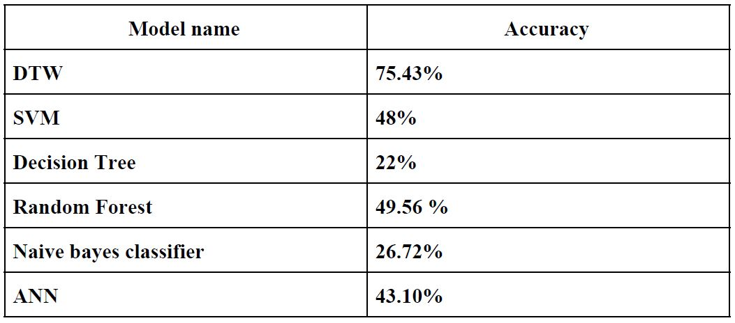
Comparison of all Accuracies

Slide 33
Windows Application
We have created a multi-threaded Windows application with the following features:
English / Hindi Speech to text conversion using the Google speech API.
Small vocabulary chhattisgarhi word recognition from the input audio file selected
For programming the user interface we have used the Tkinter package in Python.

Slide 34
Accuracy on the 5-word Dataset
So far, we have worked on 5 words. We collected data from 20 speakers, each word twice.
Trained on 180 samples out of these 200 (18 speakers)
Tested on the left 20 samples (2 speakers), in which we got 85% accuracy (17/20 correctly recognized).

Slide 35
Accuracy on the 20-word Dataset
So far, we have worked on 20 words. We collected data from 20 speakers, each word twice.
Trained on 720 samples (18 speakers) out of the total of 800 samples.
Tested on the left 80 samples (2 speakers), in which we got 87.5% accuracy (70/80 correctly recognized).

Slide 36
Accuracy on the 58-word Dataset
So far, we have worked on 58 words. We collected data from 20 speakers, each word twice.
Trained on 2208 samples (18 speakers) out of the total of 2320 samples.
Tested on the left 232 samples (2 speakers), in which we got 75.43% accuracy (175/232 correctly recognized).

Slide 37
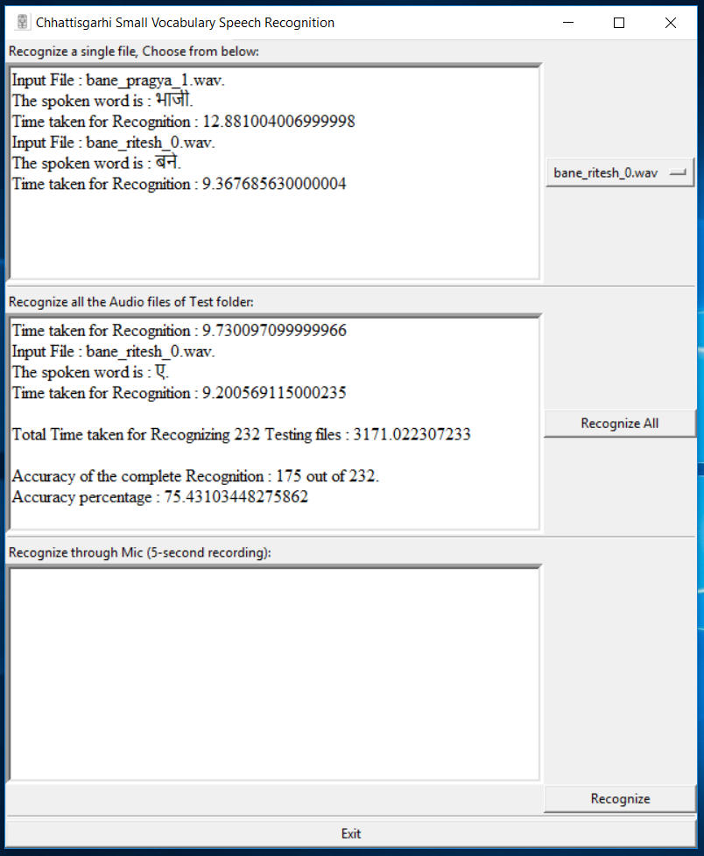
Graphical User Interface (GUI)
Developed a Windows application
using Python

